Slide 1

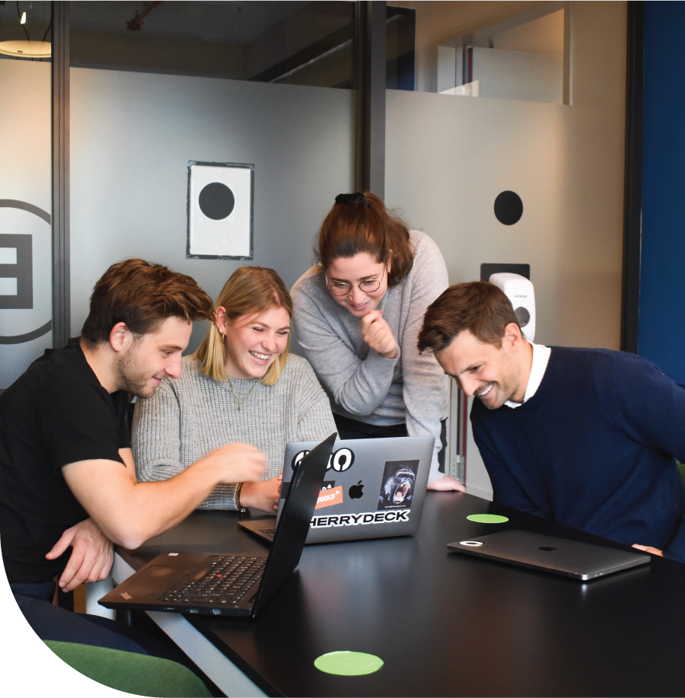

JUDUL MATERI
SUB JUDUL
27 Agustus 2022 opensourcecommunity.com

Slide 2
Content
Introduction
01
What is Python ?
02
Python for Everyone
03

Slide 3
27 Agustus 2022 opensourcecommunity.com

Slide 4
27 Agustus 2022 opensourcecommunity.com

Slide 5
27 Agustus 2022 opensourcecommunity.com

Slide 6
TERIMAKASIH
Yayasan Komunitas Open Source,
Jl. Lubuk Kasih No.1, RT.002/RW.005, Jatiwaringin,
Kec. Pd. Gede, Kota Bks, Jawa Barat 1741

